Slide 1

Combined Kalman Filter and Siamese Network for Real-Time Visual Tracking
Liming Gao, Chengyu Hu, Zekai Liu, Mingzhao Yu
Group 12
The Pennsylvania State University
03 April 2020

Slide 2
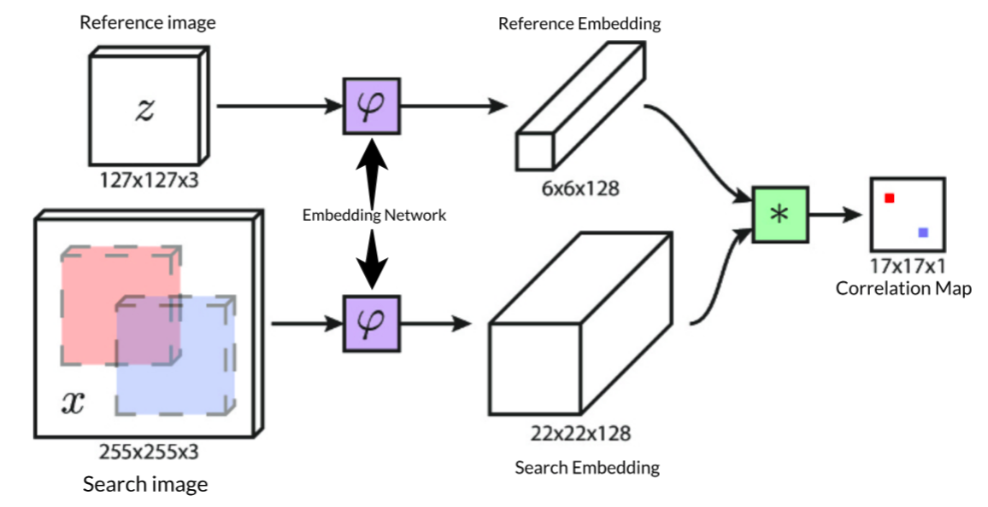
Siamese-FC
Property
Tracking offline to use limited training data to build a tracker
Uses the first two frames of the targets as the subsequent template
Trackers rely on similarity scores to predict the target’s position
Problem
Interference from similar objects
Occlusion of target
SiameseFC tracker
robots.ox.ac.uk

Slide 3
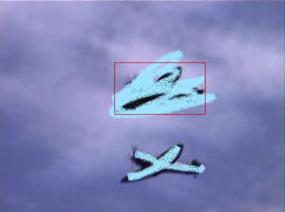
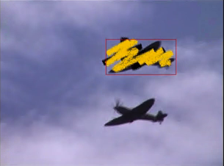
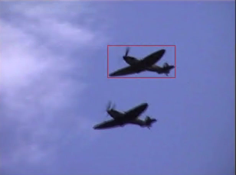
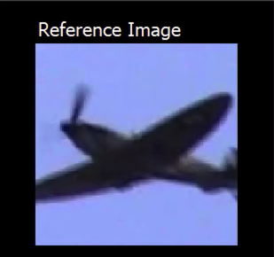
Dataset
Dataset
ILSVRC 2015
Condition 1
Both objects are occluded
Condition 2
Target object is occluded
Condition 3
Two objects (Interference)

Slide 4
此處添加第一個視頻 使用Siamese FC tracking 兩個飛機 介紹一下上述兩個問題

Slide 5
Approach to Occlusion
Kalman Filter
Obtain the target motion information
Combine with the Siamese network for stable tracking
The motion information is used to resolve the occlusion of the target and change the selection method of the search area during the tracking process
(x₁, y₁), (x₂, y₂),…,(x_{N}, y_{N} )
Positions of previous N bounding box
Gate: 0.3
If maximal <= 0.3
Maximal score in correlation map
If maximal > 0.3
SiameseFC tracker
robots.ox.ac.uk
Kalman Filter-based Heuristic Ensemble: A New Perspective on groundai.com

Slide 6
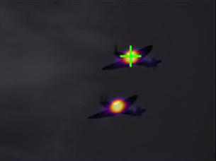
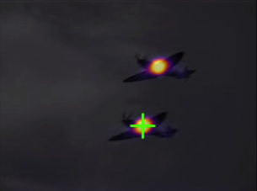
Approach to Interference
Maximal score
Gate: 0.3
If maximal < 0.3
If maximal > 0.3
The position difference between two successive frames
T
If diff_max <= 100
Gate: 100
If diff_max > 100
T-1
(x₁, y₁), (x₂, y₂),…,(x_{N}, y_{N} )
Positions of previous N bounding box
Two best scores
Interference from similar object

Slide 7
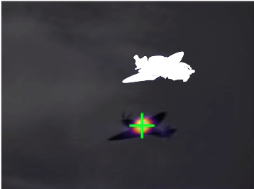
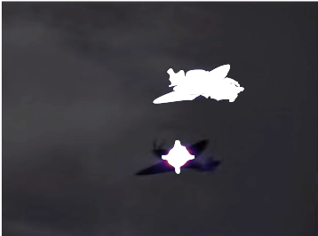
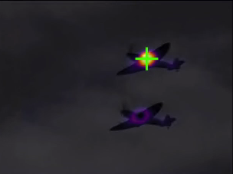

Approach to Interference
Gate: 100
If diff_max > 100
T-1
S, T
Output
W
1-W
S_new=S*(1-W)
Remove the Interference Score

Slide 8
此處添加第二個視頻 演示我們Solution完後的結果 分析一下效果

Slide 9
Result
Pros:
1. Tracking objects prevents interference from similar targets
2. Keep tracking of occlusion object
Cons:
1. The Neural networks are still slow to predict
2. Complex trajectory motion is difficult to predict
3. Variations in the shape of reference objects can lead to high errors
https://www.google.com.hk/url?sa=i&url=https%3A%2F%2Fwww.semanticscholar.org%2Fpaper%2FTrajectory-tracking-control-of-a-vehicle-with-a-Nakano-Kinugawa%2F204bd341ab34053fea6063b27abb2f560e6ef58a%2Ffigure%2F0&psig=AOvVaw2WSxu1s4oKOAlCs56_jH1&ust=1585885635946000&source=images&cd=vfe&ved=0CAkQjhxqFwoTCMDq3NHryOgCFQAAAAAdAAAAABAD
https://www.google.com.hk/url?sa=i&url=https%3A%2F%2Fwww.profillic.com%2Fs%2FTanaya%2520Guha&psig=AOvVaw0YAZtGxH4frkScFnmF3Tm3&ust=1585885773940000&source=images&cd=vfe&ved=0CAkQjhxqFwoTCMjKsYbryOgCFQAAAAAdAAAAABAm

